Slide 1

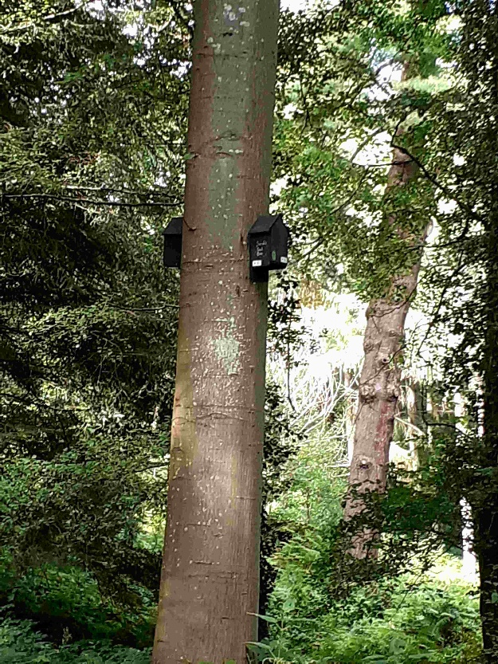


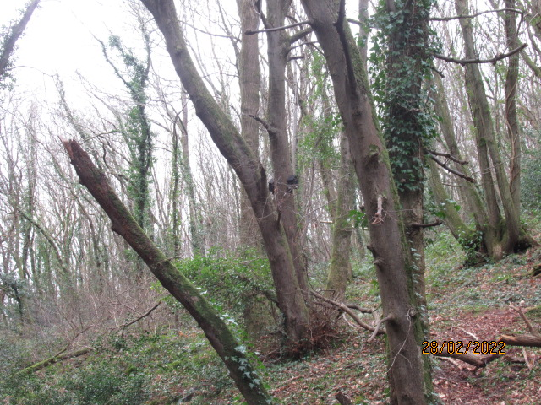
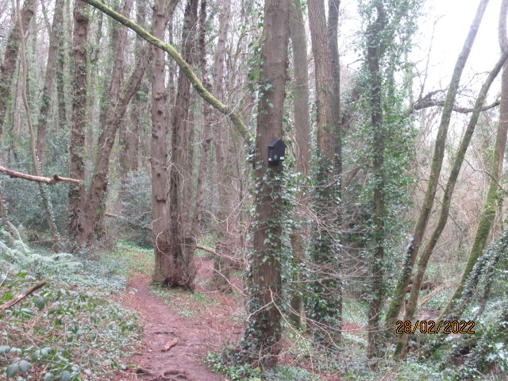
Pair 1
Pair 2
Pair 3
Pair 4
Pair 5
Advice we got => Improved Cavity Bat Box -
Schwegler – Perhaps best but German, expensive

